Slide 1
Module 15

Slide 2
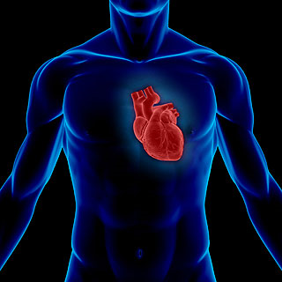
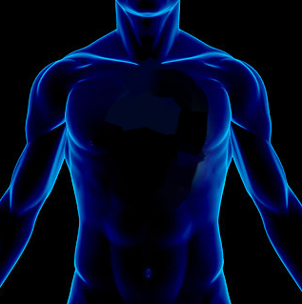
A pumping organ is needed to push the blood around the body
This pumping organ is
HEART
The involuntary pump
Without our will

Slide 3
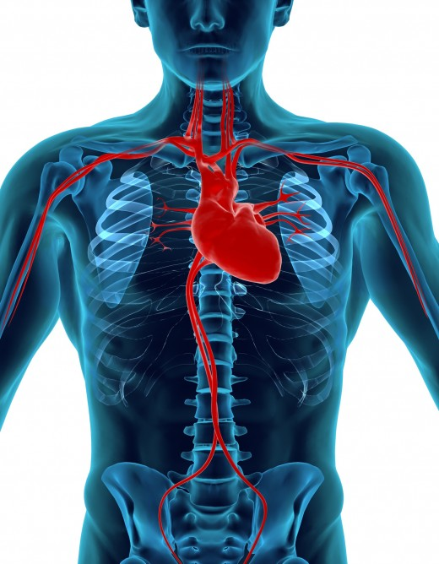
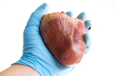
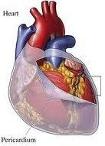
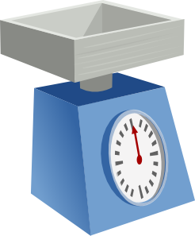
HUMAN HEART
Muscular organ
Size of the human fist
Covered by pericardial membrane
Weight of the heart is about 360 gm.
Outer
Heart
Covering
Outer covering of heart

Slide 4
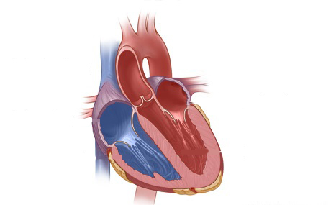
Internal the heart is divided into
RIGHT
and LEFT sides
4 chambers
2 upper
- Atria
(Atrium)
2 lower
- Ventricles
(Ventricle)
Left
Atrium
Left Side
Right Atrium
Left
Ventricle
Right Side
Right Ventricle

Slide 5
Between the atria and ventricles, there is an opening
The valves prevent the backflow of blood. i.e., they allow the blood to flow only in one direction. (from atria to the ventricles.
This opening is guarded by a valve.
The left side of the heart always deals with oxygenated blood.
Valve
Valve
The right side of the heart always deals with deoxygenated blood.

Slide 6
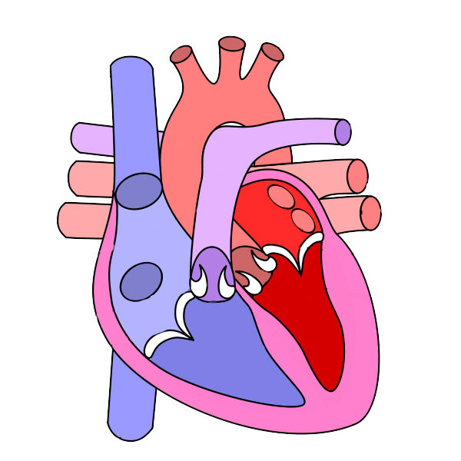
An artery leaves the right ventricle and divides into two branches. One branch enters the right lung and the other branch enters the left lung.
Four veins enter the left atrium. Two from the right lung and two from the left lung.
The largest artery of the body leaves the left ventricle.
A big vein enters the right atrium from upper part of the body.
A big vein enters the right atrium from lower part of the body.
Aorta
Pulmonary Artery
Superior Vena Cava
Pulmonary
Veins
Right Atrium
Left Atrium
Right Ventricle
Left Ventricle
Inferior Vena Cava

Slide 7
Thank You

